Slide 1
MACHINE Learning PROJECT
Classification of Stars and Quasars using KNN

Slide 2
Course and Team Information
Course Title: Machine Learning | Course code: UE17CS303
Semester : 5th semester | Section: E
Faculty In charge: Dr. Snehanshu Saha
Name: | SRN:
Srivatsa Vantmuri | PES1201701132
Shashidhar R | PES1201701417
Saransh Gupta | PES1201700267

Slide 3
KNN: Classification Approach
After loading the dataset we stored the column ‘class’ into a list and make that the last column of the dataframe.
We then dropped ‘pred’ column ,‘spectrometric redshift’ , “galex_objid” and “ssds_objid” as we don’t train our model based on that.
The spectrometric redshift column used only to verify.
We also dropped all the extinction columns as the model gave a higher accuracy after dropping.
We split the Data Set in 70:30 ratio and store it in Training Set and Test Set.
We then upsampled the Training Set
In the end we standardised both the Training and Test set using sklearn.preprocessing module.

Slide 4
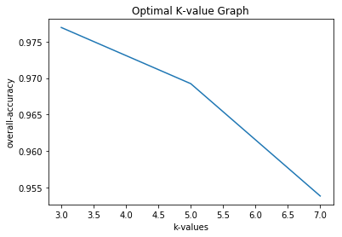
Optimal K-value Graph
We plotted K-values v/s overall accuracy Graph to determine the optimal K-value.

Slide 5
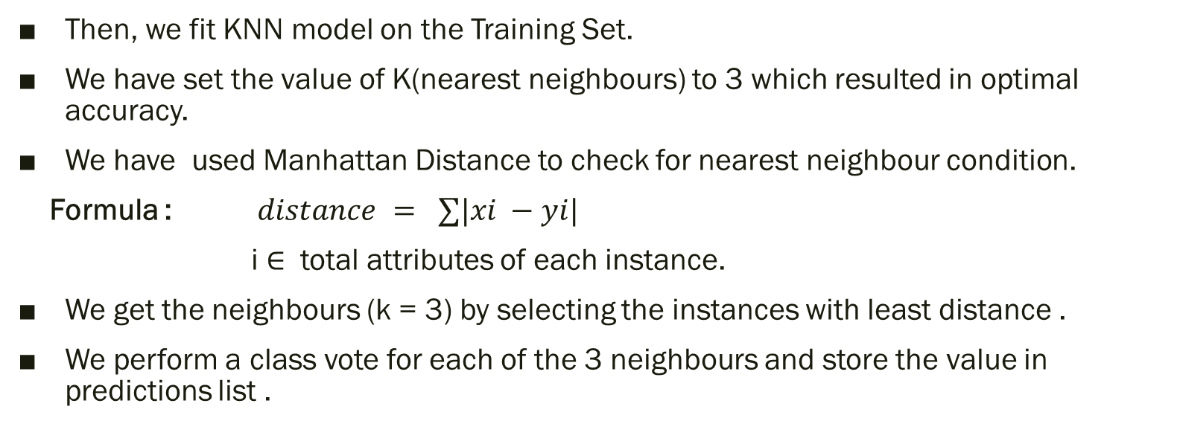
Continued …
Then, we fit KNN model on the Training Set.
We have set the value of K(nearest neighbours) to 3 which resulted in optimal accuracy.
We have used Manhattan Distance to check for nearest neighbour condition.
Formula : $distance = ∑|xi −yi|$
i $∈$ total attributes of each instance.
We get the neighbours (k = 3) by selecting the instances with least distance .
We perform a class vote for each of the 3 neighbours and store the value in predictions list .

Slide 6
Continued …
We then test our model on Test Set.
We verify predicted values with Test Set’s last column values and calculate class-wise recall, precision,f1 score and overall accuracy.
We repeat the same steps for each of the 4 catalogs.
We then plot ROC-curve for each of the catalog using sklearn.

Slide 7
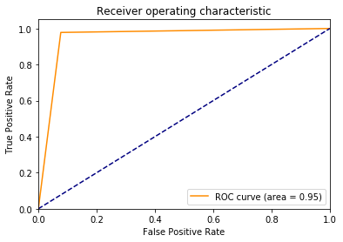
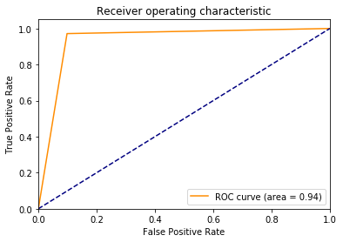
ROC-Curve
cat1.csv cat2.csv

Slide 8

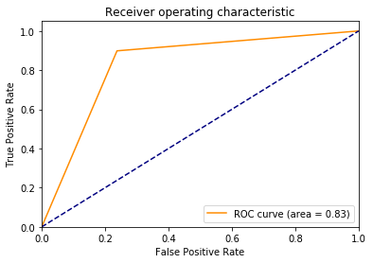
Continued …
cat3.csv cat4.csv

